Slide 1
Experiment 2
Time-domain approach to LTI system

Slide 2
1.Convolution of sequences
y1=conv(x1,x2)
y2=conv(x2,x1)
y11=conv(x11,x2)
y12=conv(x12,x2)
y13=conv(x13,x2)
y3=y11+y12+y13
y3=y2=y1?

Slide 3
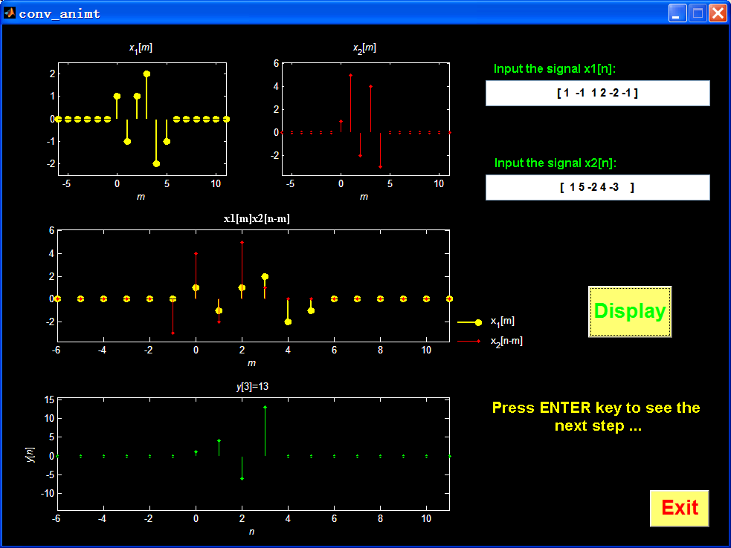
>>conv_animt

Slide 4
2.System’s impulse response
A) Ideal delay system
>> h1=[0 0 1]
>> x=[1 2 3 4 5 6]
>> y=conv(x,h1)
B) y=?
>> h2=ones(1,length(x))

Slide 5
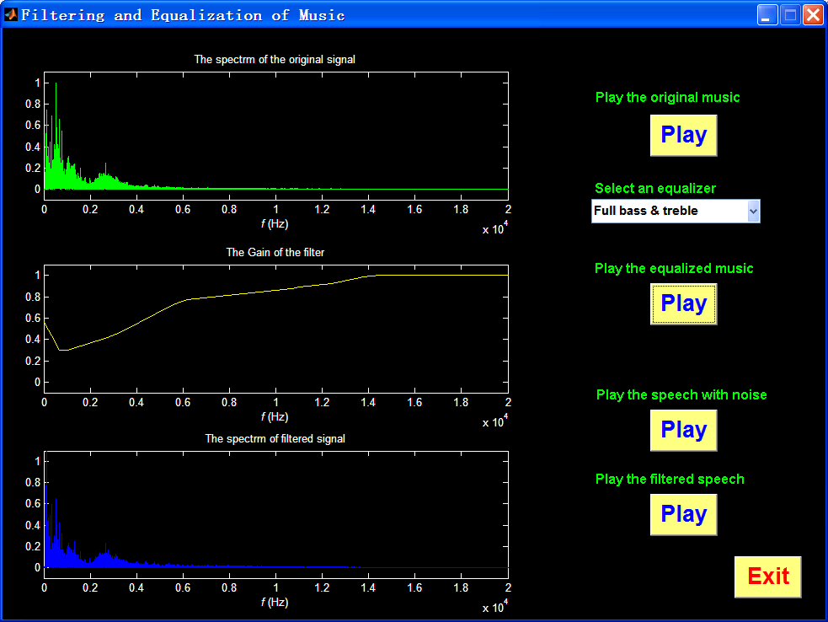
3.Music equalizer
Msceq.m

Slide 6
4.Graphical convolution (optional)
4.1 The reversed sequence
x1=[1 -1 1 1];
x2=[1 2 3 4];
x2_rev=fliplr(x2) ; %reversed sequnce
subplot(3,1,1)
stem(x1);
subplot(3,1,2)
stem(x2);
subplot(3,1,3)
stem(x2_rev);

Slide 7
4.2 The time shifted sequence
N1=length(x1);
N2=length(x2);
result=zeros(1,N1+N2-1); %convolution result define
x1_filled=[x1 zeros(1,N2-1)];
n0=1; %shift n0
x2_rev_shift=[x2_rev(N2-n0:N2) zeros(1,N1+N2-n0-1)];
……
n0=4;
x2_rev_shift=[zeros(1, n0+1-N2) x2_rev(1:N2) zeros(1,N1+N2-1-n0-1)];
……

Slide 8
4.3 Multiplication and add
result(n0+1)=sum(x1_filled.*x2_rev_shift);

Slide 9
4.4 Plot
n=0:N1+N2-2;
subplot(2,1,1);
stem(n,x1_filled);
hold on;
stem(n,x2_rev_shift,'r');
subplot(2,1,2);
stem(result);

